Slide 1

Nuclear Reactions
Fission and Fusion
Rohan Singh
University of Delhi, Ramjas College
Bsc(H) Chemistry, Roll No 107
1

Slide 2
Concepts
Nucleons
Nuclear Binding Energy
Nuclear Fission
Nuclear Fission Chain (Nuclear Bomb and Nuclear Reactor)
Nuclear Fusion
Energy in Nuclear Reactions
2

Slide 3
Nucleons and Binding Energy
Nucleas consists of subatomic particles, mainly protons and nuetrons collectively known as nucleons.
Protons and Nuetrons are baryon particles (hadrons composed of odd number of Quarks), both of which are made up of 3 quarks.
Quarks are fundamental particles (Fermions or spin-half particles) and are main constituent of all nucleons. These quarks are joined together by gluons (a boson or spin-integral particle) which are responsible for 70% of spin angular momentum of nucleons. Nucleons, namely Protons and Nuetrons only vary in type and arrangement of constituent quarks.
Quarks can be UP or DOWN which have +2/3 and -1/3 of electronic charge respectively. Being fermions, quarks also have half-integral spin and obeys Pauli’s exclusion principle (no two UP or DOWN quarks can have same spin). They forms the basis of nuclear spin (i.e NMR) and other nucleonic phenomenon's.
3

Slide 4
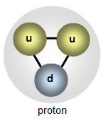
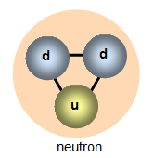
But why proton is charged and neutron is not?
Proton is composed of two UP and one DOWN quarks. This results in net electronic charge of +1 (2/3 +2/3 -1/3) and spin of +1/2 (1/2 -1/2 +1/2).
Neutron is composed of one UP and two DOWN quarks. This results in net electronic charge of 0 (2/3 -1/3 -1/3) and spin of +1/2 (1/2 -1/2 +1/2).
Hence both Proton and Neutron are composite Fermions and have almost similar mass (1.67E-27 kg). They are so similar and yet too different….
Since nucleas is primarily composed of protons and nuetrons, there must be some force holding like-charged protons in such a small space.
This follows from fact that mass of elemental nucleas is always less than combined mass off all it’s constituent nucleons. This lost mass or “mass defect” is supposed to be the origin of what is called the Nuclear Binding Energy. This energy is responsible for binding nucleons inside nucleas and holding them intact.
Nuclear Reactions like Fission and Fusion aims to harness this energy hidden within atomic nucleas itself.
4

Slide 5
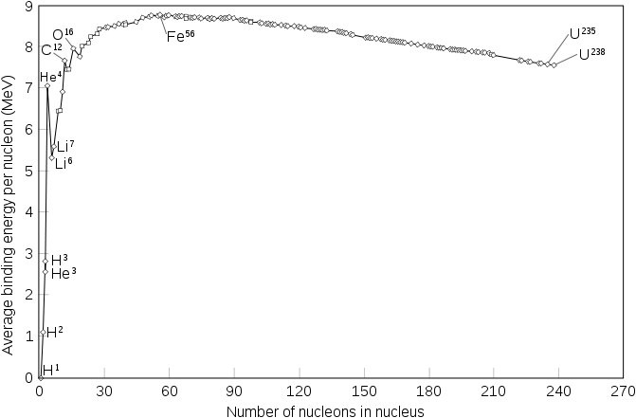
Nuclear Binding energy is a direct consequence of mass-energy equivalence as proposed by Albert Einstein.
It is the lost mass or mass defect that gave rise to nuclear binding energy (consequently stability of nucleas, atom and matter) in first place…..
The variation of Nuclear Binding energy with no of nucleons (or mass no) of some common isotopes is represented in adjacent graph.
Binding Energy increases up to Iron and decreases afterwards. This is also known as Iron Peak and has a rather peculiar significance in nuclear reactions.
Energy absorbed or released in a nuclear reaction can be explained using Iron Peak.
Iron Peak
Fission energy
Fusion Energy
5

Slide 6

Nuclear Fission
Nuclear Fission is the splitting of heavy and unstable nucleas (usually with n/p ratio > 1.5) into lighter nuclei (daughter nuclei) and nuetrons. Nucleus usually divides asymmetrically rather than into two equal parts, and the fission of a given nuclide does not give the same products every time.
Fission of nucleas heavier than Iron release energy and vice-versa.
Most common example is the neutron induced fission of Uranium 235.
U-235 nucleas is highly unstable (n/p=1.54). When it is bombarded with a neutron, it absorbs it and forms even more unstable U-236 which instantly splits apart into two daughter nuclei (products vary with reaction condition, but usually Barium and Krypton or Strontium and Xenon), releasing three very high speed neutrons (or neutron flux) and about 202 MeV of energy.
Neutrons produced as fission product can initiate fission of other U-235 nuclei as well.
6

Slide 7
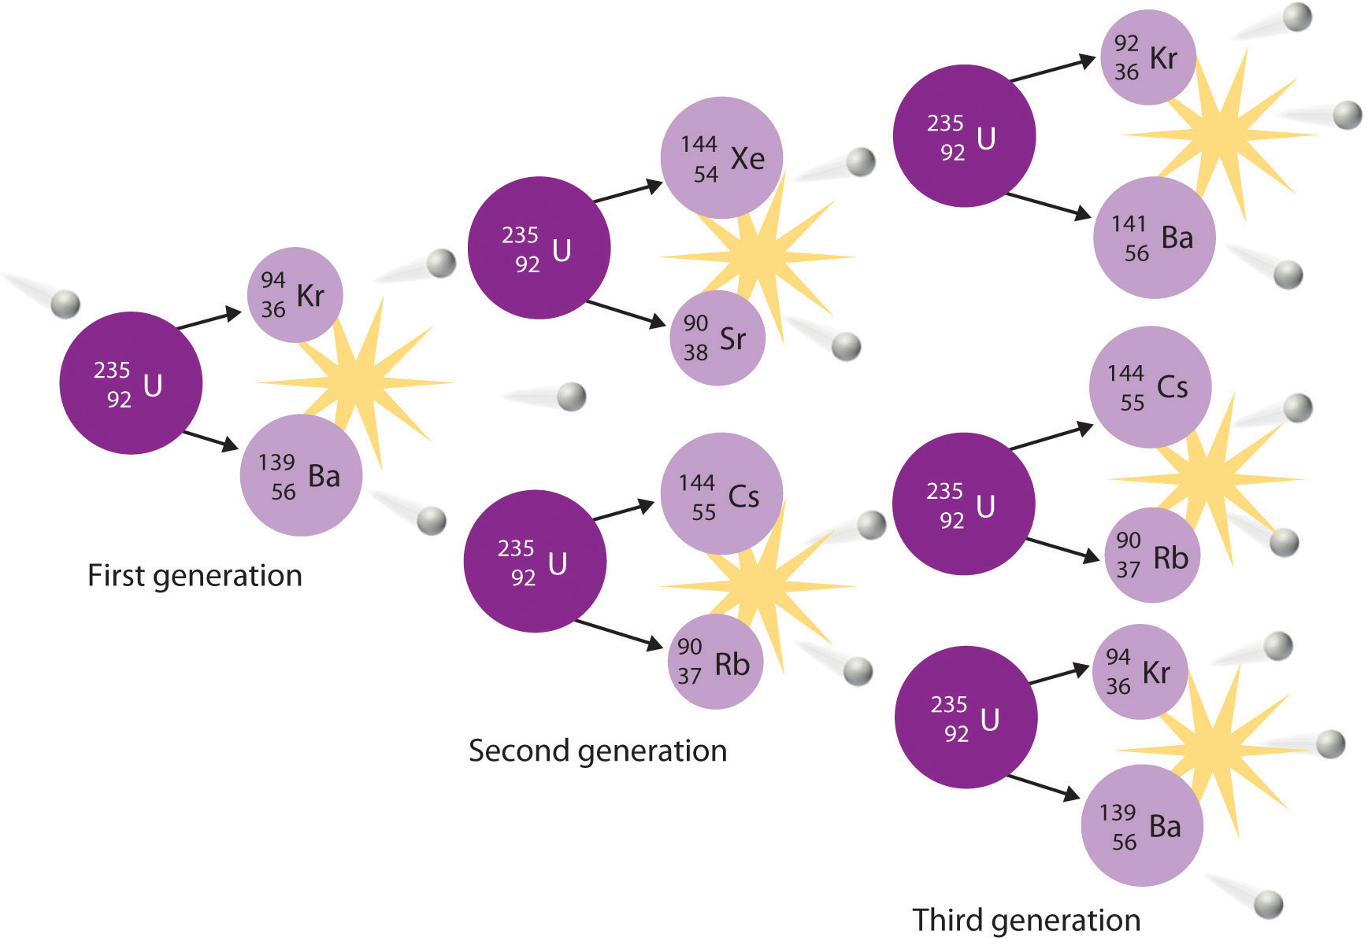
7. Nuclear Fission Neutron induced fission chain reaction of Uranium-235.

Slide 8
Nuclear Fission Chain
When amount of radioactive isotope undergoing fission exceeds a certain value, known as it’s Critical Mass, a self sustained nuclear fission chain reaction can occur. If the mass is too low, major part of neutron flux will escape out, without inducing successive fission reactions.
This supercritical mass under right conditions, can undergo self sustained and uncontrolled fission chain reaction that can release energy explosively. This forms the basis of Nuclear Bomb.
On contrary, Nuclear Reactors are based on principle of controlled nuclear fission. Excessive neutron flux is captured using Control rods made of neutron absorbing elements like Boron, Cadmium or Halfnium. This way fission chain is controlled to propagate in constrained directions only.
Nuetrons as flux travels at very high speeds (near speed of light and penetrates everything in their way). They are required to slow down in order to increase the probability of successive fissions and sustain fission chain. In a nuclear reactor, a moderator is thereby employed. It can be water itself, running around the core or graphite as control rod tips.
8

Slide 9
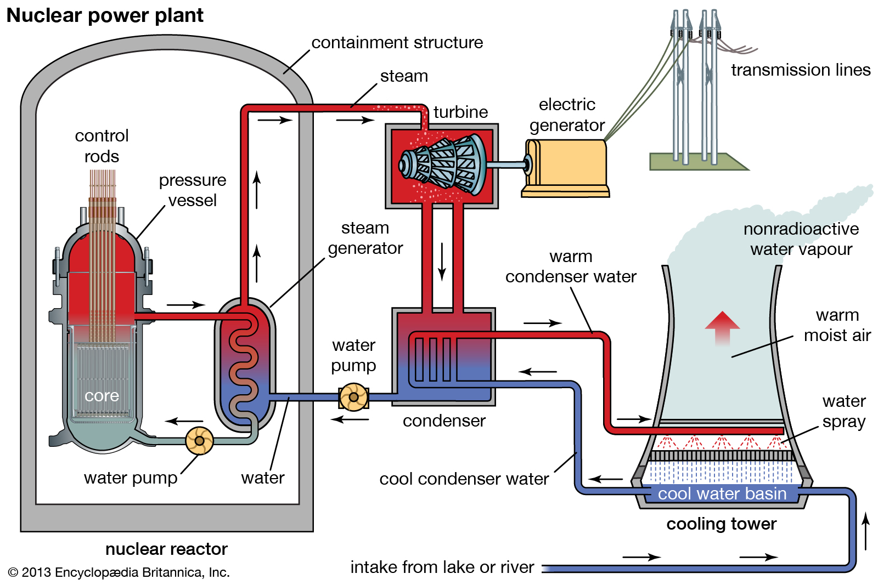
9. Nuclear Reactor A typical Nuclear Reactor that converts nuclear energy to electrical energy.

Slide 10


Nuclear Fusion
Nuclear Fusion is a reaction whereby two light nuclei combines to produce a heavier, more stable nucleus. It is essentially the opposite of nuclear fission.
Nuclei lighter than iron release energy upon fusion, while fusion of heavier nuclei requires energy. Energy released in a fusion reaction is much higher compared to Nuclear Fission and increases with the decrease of no of nucleons in nuclei.
Hydrogen and it’s isotopes are primary fusion reactants. Two Deuterium nuclei fuses to form a Helium-3 nuclei and a neutron (D-D Fusion)
Deuterium and Tritium fuses much the same way producing a Helium-4 nuclei and a neutron (D-T Fusion).
10

Slide 11
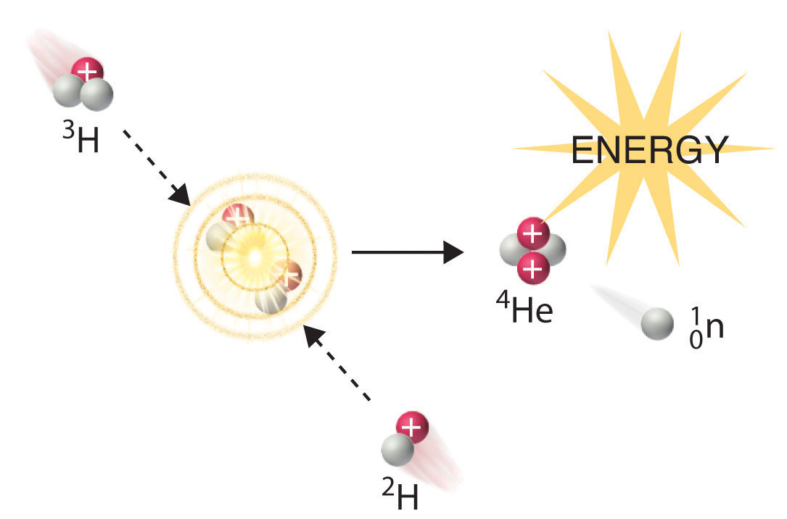
11. Nuclear Fusion Nuclear Fusion reaction of Deuterium and Tritium.(D-T Fusion)

Slide 12
Nuclear fusion requires two fusing nuclei to be in very close proximity. However positive charge on both the nuclei imposes a very large electrostatic energy barrier on Nuclear Fusion Reactions.
In general, Fusion reactions requires one or both the fusing nuclei to have enormous kinetic energy so as to overcome electrostatic repulsion between them and approach close enough to undergo a nuclear fusion reaction. This is similar in principle as supplying heat to increase rate of a chemical reaction.
Thus, fusion requires a temperature similar to that in the interior of the sun (approximately 1.5 × 10⁷ K), and the only method to achieve such a temperature on Earth is the detonation of a fission bomb….. However, once Initiated, it releases vast amount of heat and radiation, and when uncontrolled can produce almost infinite amount of energy.
Hydrogen Bomb, or a deuterium–tritium bomb (a D–T bomb), uses nuclear fission to initiate nuclear fusion in first place.
Fusion reactions are the ultimate power source for stellar energy, like Sun and stars. It drives whole universe and sustains life processes.
12

Slide 13
Energy
Albert Einstein in his ground breaking article “Special Theory of Relativity” published in 1905, proposed that conservation of mass and energy are not entirely true, when considered separately. In fact, mass can be destroyed and converted to energy. This is exactly what happens in nucleas of every atom.
He proposed a simple equation known as Einstein’s mass energy equivalence, now is the most famous equation in world which governs energy involved in all nuclear reactions
E = mc²
m : mass lost or (mass defect)
c : speed of light (299,792,458 m/s)
E : energy equivalent of mass lost
Energy absorbed or evolved in a nuclear fission/fusion reaction can be calculated using this equation.
13

Slide 14
References
William E. Stephens. Nuclear Fission and Atomic Energy. Inman Press 2007.
Petrucci, Herring, Madura, Bissonnette. General Chemistry: Principles & Modern Applications (10th edition). New Jersey: Pearson Education, 2011
"Nuclear Fission vs Nuclear Fusion - Difference and Comparison | Diffen." Diffen - Compare Anything. Diffen. Discern. Decide. Web. 04 June 2011
https://chem.libretexts.org
https://en.wikipedia.org
14

